Slide 1
Credit Risk Insights & Optimisation
Faisal Jina

Slide 2
Conversion Funnel
72m Quotes
0.2% take out an application
120k Applications
44% accepted for a loan
52k Loans
Quotes to Applications:
Customers are willing to get a quote without obligation of applying
Able to compare with other options
May be dropping out before completing application – potential for better retention?
Applications to Loans:
Good accept rate
Always potential to improve production at appropriate risk level

Slide 3
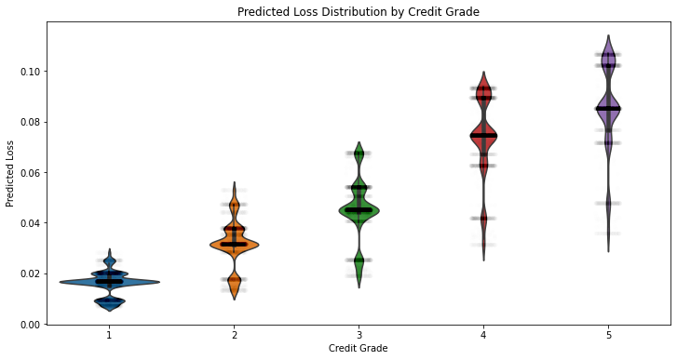
Predicted Loss
Splitting the data by Credit Grade, we see approximately 7 clear bands of predicted loss rates per grade
There may be potential to improve predicted loss by providing more granularity from actual default rates
Improving prediction could help improve risk management on the portfolio
Notes:
5 – 7 clear bands of predicted loss

Slide 4
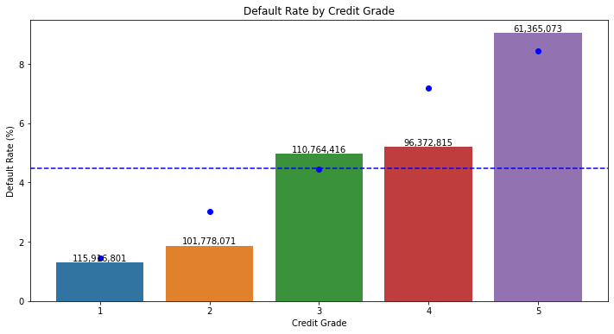
Default Rates
The predicted loss estimates are shown as blue dots per credit grade, and a dotted line for the portfolio
Predicted default rates show a clear upward trend across credit grades, suggesting a strong link
There is scope to improve predicted rates here, with actual default rates varying by Credit Grade
Notes:
Actual default rates shown as bars, with paidout volumes as labels

Slide 5
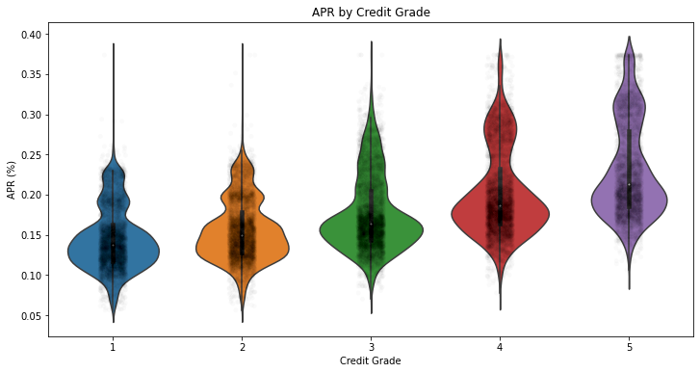
Pricing
Splitting by credit grade shows similar distributions of APR across credit grades.
The tri-modal shape suggests larger shifts in overall pricing have occurred, possibly due to external events.
This upward pattern across credit grades suggests that grade is being used in decisioning of the APR offered to the customer as expected.
Notes:
Predicted loss determines credit grade, and credit grade determines APR – the better our loss prediction, the better we can price loans

Slide 6
Optimisation
Objective:
To identify opportunities from default rate prediction
Method:
Split data into individual pots based on input data (Loan purpose, Residential status, Income etc.)
Calculate default rates weighted by loan amount, compare to predicted loss rates
Find segments of population where risk is under- or over-predicted
Identify opportunities to relax strategy, and areas to tighten
Segmentation on:
Loan amount
Loan Purpose
Residential status
Unsecured Debt
Debt to Income
Annual Income
Disposable Income
Metrics:
‘Additional loss’ – compound metric using difference in actual default rate and predicted default rate alongside value of loans in segment
‘Profitable’ – uses average loan amount and difference between APR and default rate
‘Opportunity gain’ – looks at potential from declined application value
Notes:
Note ‘Channel’ was left out of segmentation, as it wasn’t apparent that it drove a different customer risk profile.

Slide 7
Under-predicted Risk Segments
4 ‘pots’ were identified as having the best opportunity for reducing risk
These were all for loans in the 7500-15000 band, for Homeowners, with Debt-to-Income of 5-9, and Disposable Income <£500
Predicted default rates are 5.11-5.56%, but actual rates exceed 14%, with accepted volumes totalling 1472 loans
We currently accept >70% of loans in each of these segments, totalling £21.5m.
Under-prediction of losses has resulted in an additional loss of £2.95m through default.
Suggestions:
Target these segments to reduce accept rates
Increase APRs as mitigation
Discourage longer term agreements to reduce likelihood of default
Notes:
Pots 38, 41, 43, 53
Based on the ‘additional loss’ metric, but also ‘profitable’ metric, suggesting that not only were these the most unprofitable loans individually, they also had enough volume to cause the biggest loss
3 were Debt Consolidation, 1 was Home Improvement

Slide 8
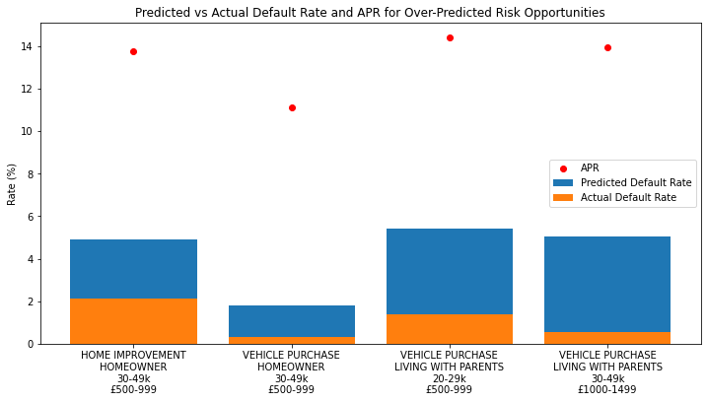
Over-predicted Risk Segments
4 ‘pots’ were identified as having the best opportunity for improving production at lowest risk
These were all for loans in the 7500-15000 band, with customers having Unsecured debt <10k, Debt-to-Income <5, and Disposable Income >£500
We currently only accept ~60% of applications in these segments by volume
Suggestions:
Increase accept rate by relaxing strategy/cutoffs
Offer lower APRs to attract these low-risk customers
Offer promotions to these segments
Notes:
Not necessarily a case of targeting this specific segment, where they fit the exact criteria on income and disposable income, but it does show where the attention should be
Targeting in practise would be more broad than this, and an analysis of where to adjust strategy with ordinal data should set a cutoff rather than target a specific segment within those categories
Second loans not currently possible at XYZ, but perhaps something for the future for offering to existing customers

Slide 9
Further Analyses
Additional sources:
Time series data to monitor trends in defaults
Open banking data, to improve affordability assessment and reduce fraud
Use CRA data to improve default prediction and set policies
Insurance data of customers
Modelling opportunities:
Segment borrowers by risk and APR sensitivity to improve takeup
Dynamic pricing - base APR on Credit risk and default probability
Notes:
Bring in multi-bureau data
Increase granularity across credit limits
Risk-based pricing
Model to optimise APR and term based on risk

